Slide 1
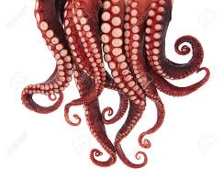
Galaga 2: The Retenticalling
Group 9: Colton Watson, Christian Giauque, Nathan Hummel, Benjamin Leaptrot

Slide 2
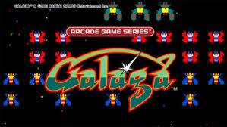
The Game
Similar to Galaga
We will include the ability to move forward and backward
Players use a PS2 Keyboard or the Mobile App
Mobile App communicates via Bluetooth
Keyboard directly connected to the FPGA
Up to 2 Players
Sound presented through Bluetooth

Slide 3
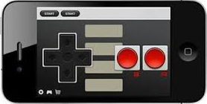
Bluetooth Communication (Mobile App Controller)
Plan
Create a Shift Register in the FPGA To Store Received Input from Arduino
Mobile App
GUI will be similar to an NES-Controller
When a button is pressed, App will send data to Bluetooth-Module of Arduino

Slide 4
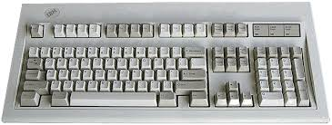
Keyboard Communication
Plan
Create a Shift Register in the FPGA to Store Input From Keyboard

Slide 5
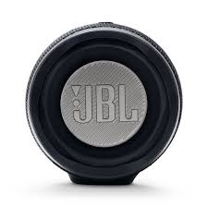
BlueTooth Communication(Speakers)
Plan
Use Same Arduino and BlueTooth Module used for Mobile App to send sound data to speaker

Slide 6
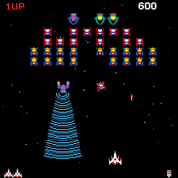
The View
Plan
Send Display Data from FPGA via VGA Cable to Connected Monitor
Example:

Slide 7
Block Diagram
Here will be a block diagram of the whole ciabatta

